Slide 1
1 min
Retail Analytics – Promotional Effectiveness Model
PGPBA-BI Capstone Project Report
Submitted by: M Anju Rao, Ruma Sinha, Santosh Kumar, Shubha Chodagam
Group No: 3
Batch: PGPBA-BI 2017
Project Mentor: Rajarshi Pandit
Program Director: Dr. P K Vishwanathan
Great Lakes Institute of Management, Bengaluru

Slide 2
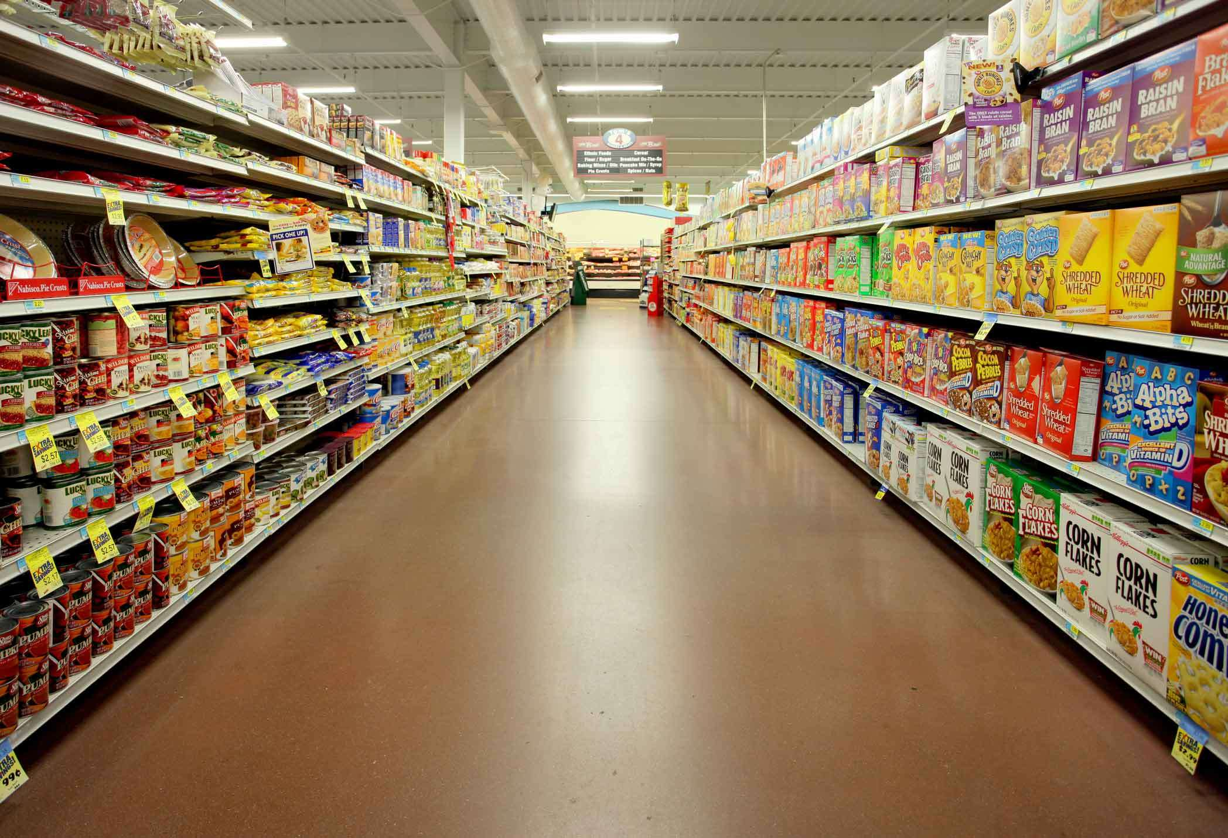
3 mins
Executive Summary
Analysis Framework
Promotional Effectiveness Analysis
Insights/Recommendations
Way Forward

Slide 3
Executive Summary
3 mins
Problem Statement
Analyzed the impact of three In-store Promotions on Sales to identify an effective promotional model
Data
Retail Industry : Food Products, Category : Bag Snacks, Frozen Pizza and Boxed Cold Cereal
Sales and Promotion information available from a sample of 77 stores for a duration of 156 weeks.
Approach
EDA
Segmentation : K-Means Clustering
Modeling : Multiple Linear Regression on Cluster Segments at Category Level
Findings / Insights
Sales in Cold Cereals Category was high
Feature promotions were less compared to Display
No distinct Trend observed between Base Price and Sales
Existing Store Segments did not have distinct characteristics
New Segments : High, Medium and Low, Key Distinct Features : Total Sales, Number of Promotions and Store Size
Regression Model Accuracy better for BAG SNACKS
In High Segment Cluster, Feature is more Effective Promotion, followed by Display and TPR

Slide 4






Can Retail stores identify which promotions are effective to improve the sales?
3 mins
Exploratory Data Analysis: EDA was carried out to understand the data behavior, availability, missing values, recoding methods etc.
Clustering & Segmentation:
First step was to use clustering (segmentation) techniques to identify a meaningful arrangement of stores and products in the stores.
Modelling: Used multiple regression
analysis (mixed model) to understand the promotion’s major influence by product category and understand the contribution by each promotion method. Above information along with the historical promotion plans was used to understand the contribution by each promotion method
Data Restrictions like no customer based inputs on promotions and non-availability of various other store specific aspects.
Root cause analysis for promotion failure cannot be done as the variables like length of promotion run time and cost of promotion are not available.
Scope for further analysis at product manufacturer level while possible could not be performed in this phase of project.
Analyzed Dunnhumby source data: “Breakfast at the Frat” which contains sales and promotion information on the top five products from each of the top three brands within three selected categories: Bag snacks, frozen pizza and boxed cereal gathered from a sample of stores over 156 weeks.
for Exploratory Data analysis and visualization
to prepare data and run clustering (k-means) and linear regression, visualization using R packages

Slide 5
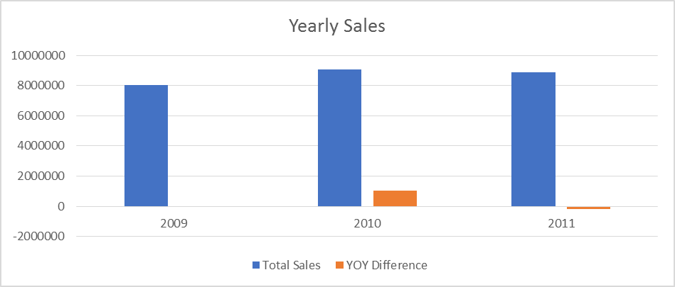
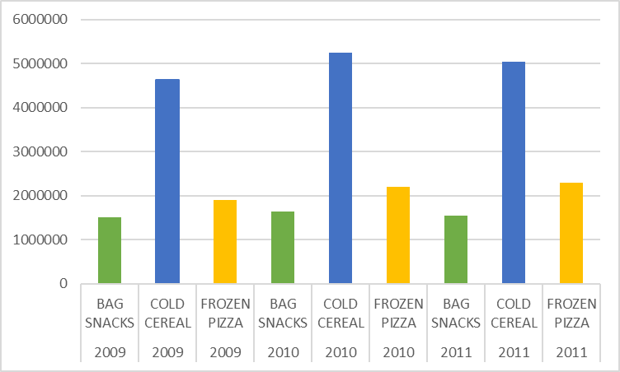
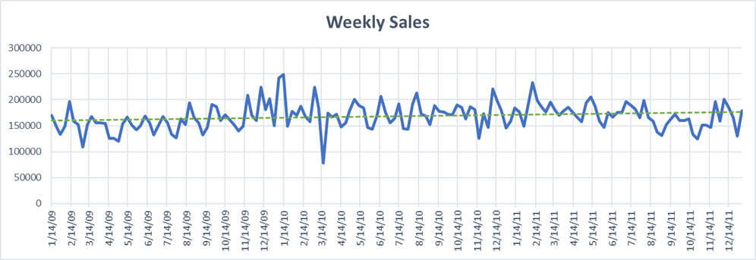
Exploratory Data Analysis

Slide 6
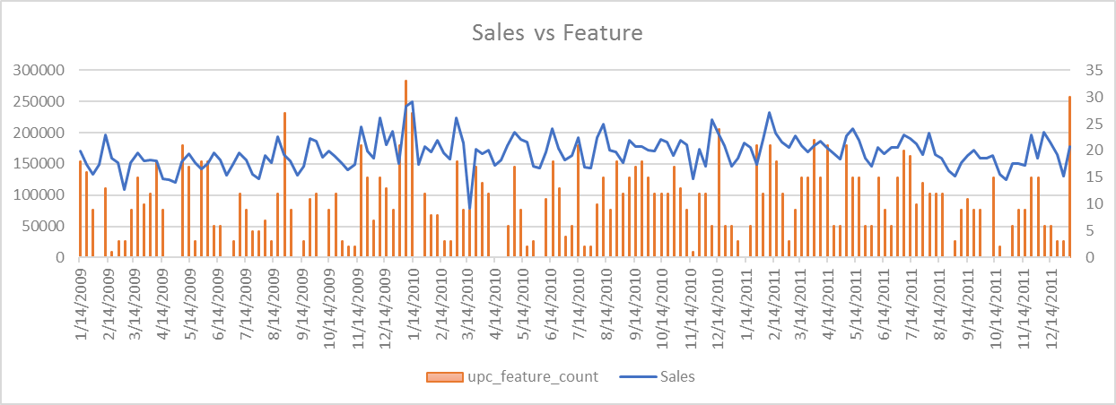
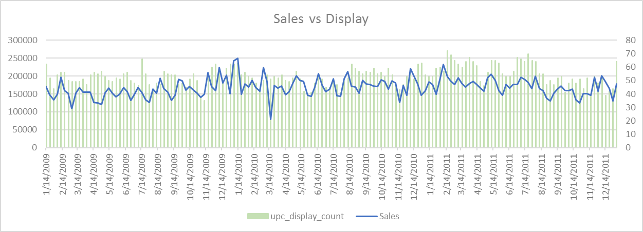
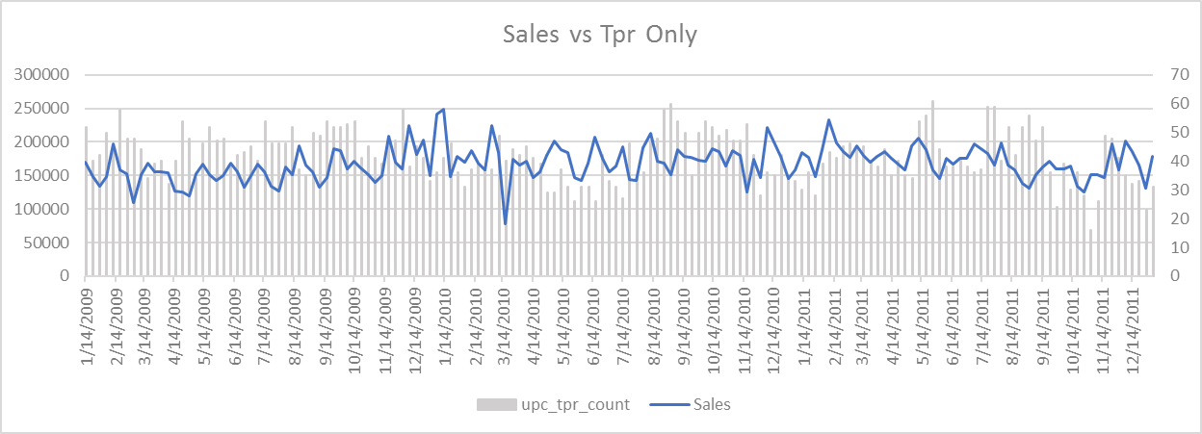
Exploratory Data Analysis

Slide 7
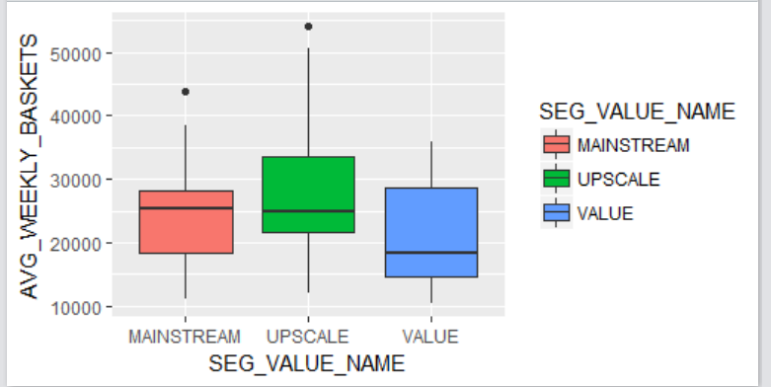
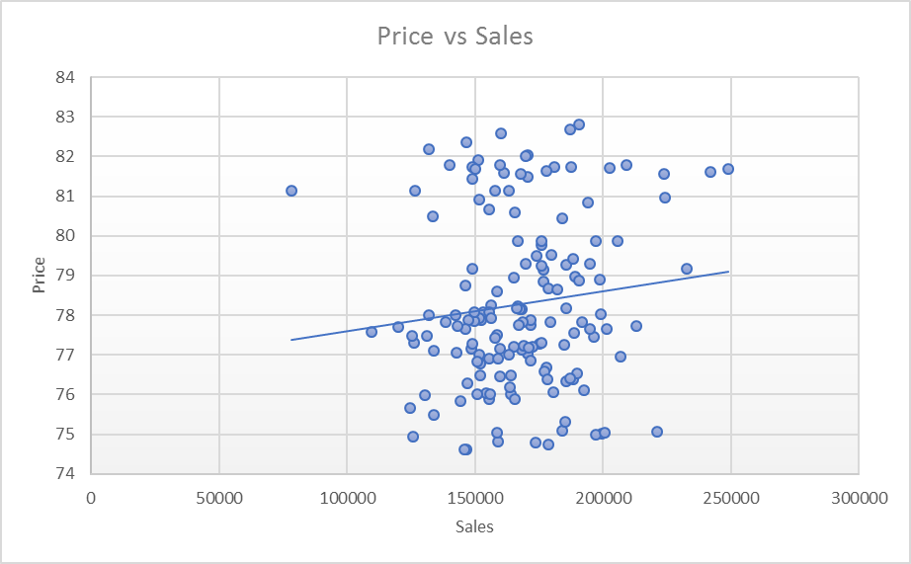
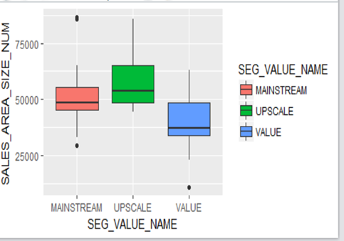
Exploratory Data Analysis

Slide 8
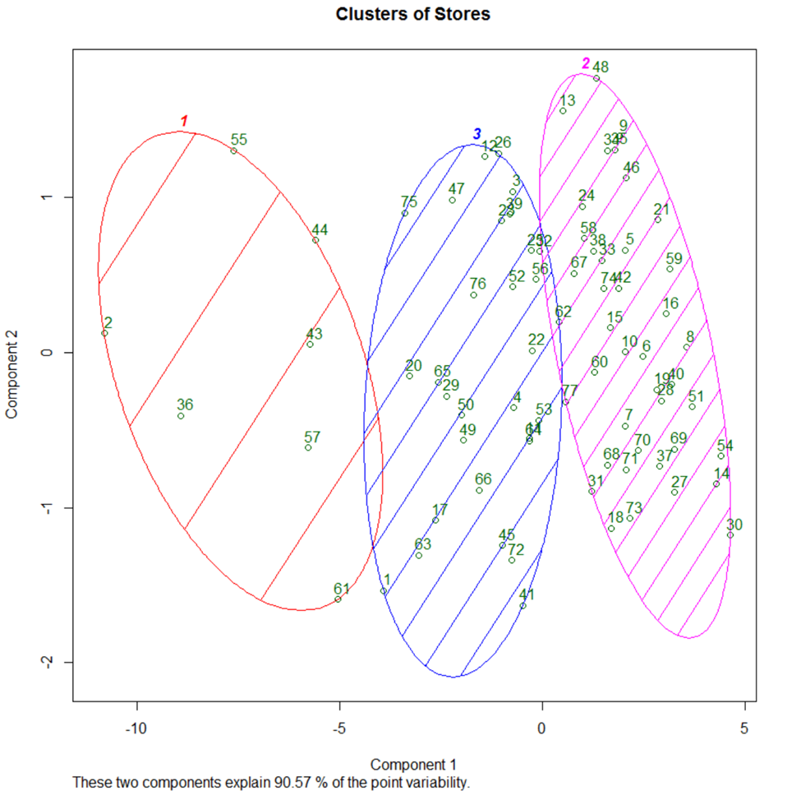
Clustering (Segmentation)
4 mins
Predefined Segments
Attributes | UPSCALE | MAINSTREAM | VALUE
Number of Stores | 15 | 43 | 19
Average SALES_AREA_SIZE_NUM | 58555.80 | 50075.98 | 38706.37
Average AVG_WEEKLY_BASKETS | 28344.56 | 24024.13 | 21363.45
Newly Formed Segments
Attributes | High Segment | Medium Segment | Low Segment
Number of Stores | 7 | 30 | 40
Average SALES_AREA_SIZE_NUM | 73885.0 | 51872.2 | 42341.6
Average AVG_WEEKLY_BASKETS | 40588.18 | 25527.27 | 20354.40

Slide 9
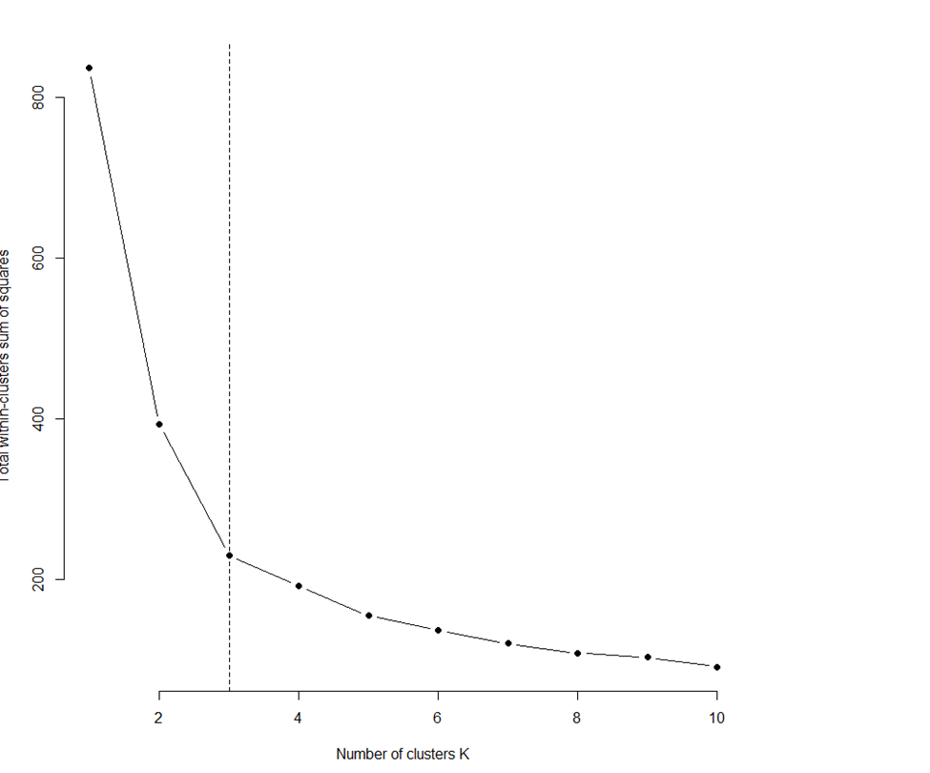
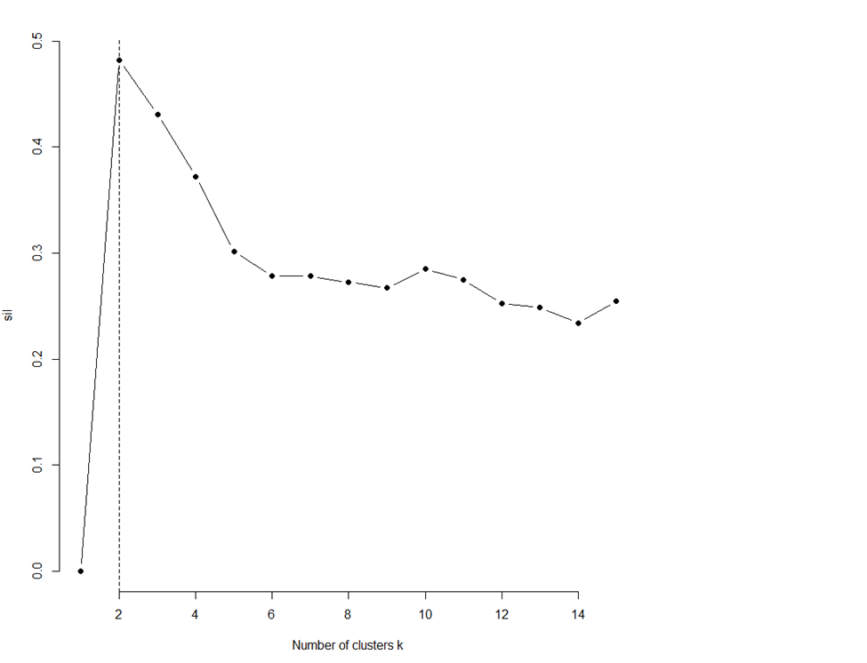
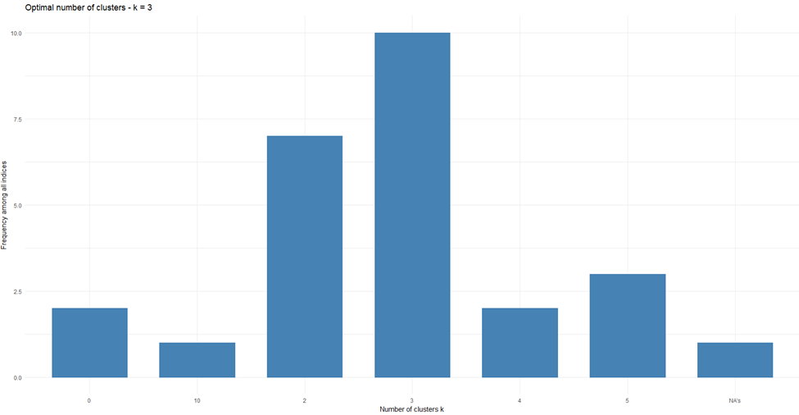
Clustering (Segmentation) : Optimum Number of Clusters
10 mins
The Elbow method
Average Silhouette method:
NbClust method:
Methods : Elbow method, Silhouette method and NbClust Method
Result : Elbow: 3 Clusters, Silhoutte : 2 Clusters, NbClust : 3 Clusters

Slide 10
Multiple Regression
4 mins
Estimation of Baseline Sales and Incremental Sales from Total Sales
Determine the effectiveness of Promotion on the Incremental Sales
Variation in Product Size within Category
Quarterly Variation in Sales
Weekly Variation in Sales
Necessity for New Engineered Features
Dependent Variable : Total Sales
Independent Variables : New features + Base price
Determination of Promotional Effectiveness
Promotional Support
Yearly Contribution
New Engineered Features
Weighted_avg_base_price
Seasonality
Trend
upc_feature_count
upc_display_count
upc_tpr_count
upc_featdisp_count
Dummy

Slide 11
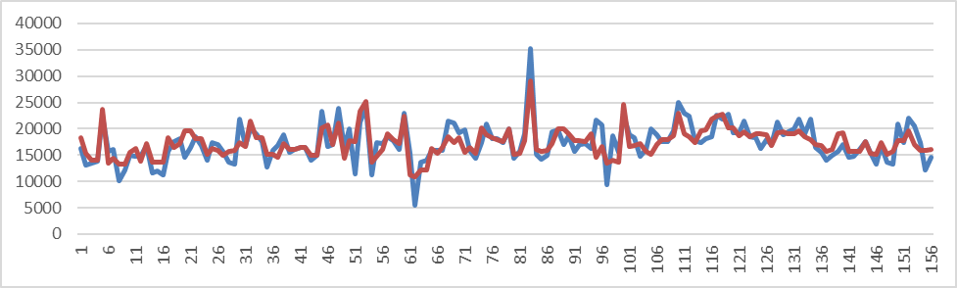
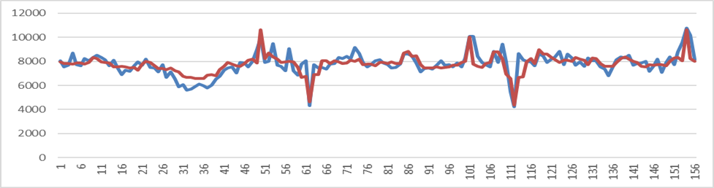
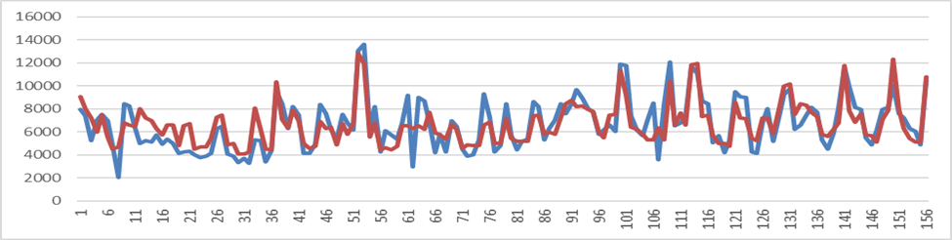
Multiple Regression
4 mins
Legend
Blue : Actual Sales
Red : Predicted Sales
Plot of Model Fit vs Actual Sales
Cold Cereals
Adjusted R^2 = 0.58
Bag Snacks
Adjusted R^2 = 0.73
Frozen Pizza
Adjusted R^2 = 0.66

Slide 12
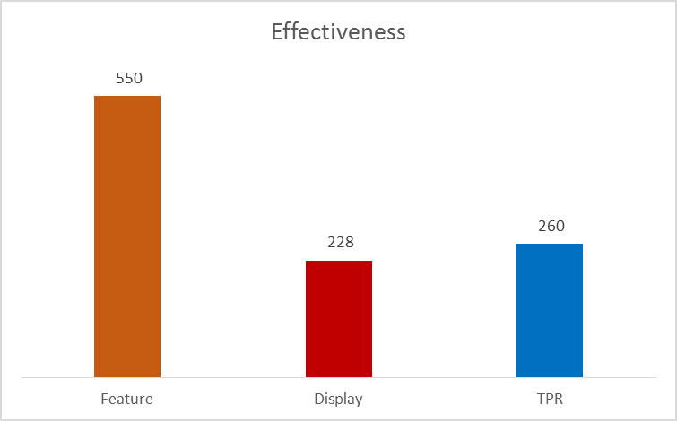
Promotion Effectiveness – Year Wise
High Segment : Frozen Pizza
Effectiveness : Sales due to Promotion / No of Promotions
Order of Effectiveness : Feature followed by TPR followed by Display
Year : 2009
Year : 2010
Year : 2011

Slide 13
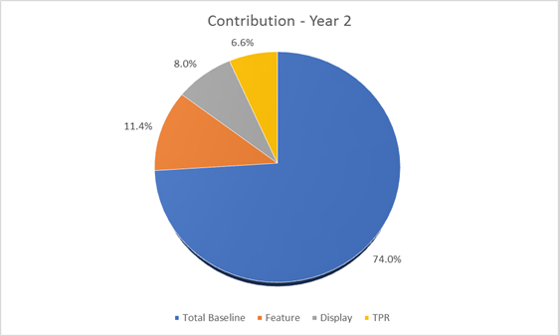
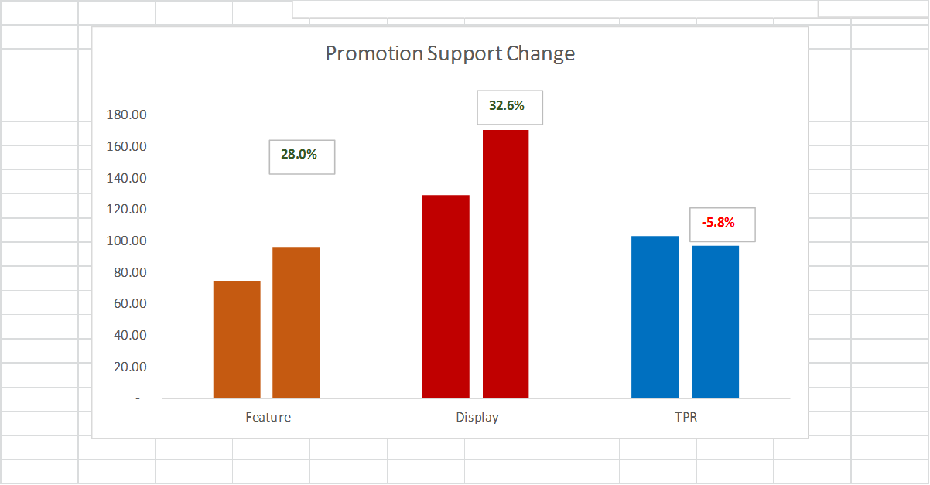
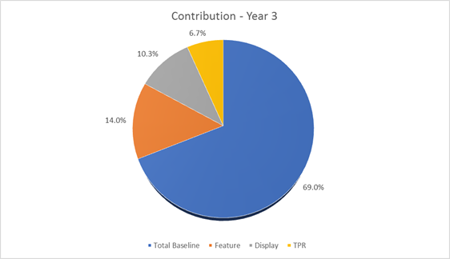
Promotion Support Change Over Two years
No of Promotions | Feature | Display | TPR
2009 | 78 | 176 | 98
2010 | 75 | 129 | 103
2011 | 96 | 171 | 97
Baseline sales in 2011 was less than 2010
Incremental Sales (promotion) in 2011 was more than 2010
In all 3 years, Percentage contribution of sales due to Feature was more than Display which was more than TPR

Slide 14
Promotion Effectiveness – Year Wise
High Segment : Cold Cereals
Year : 2011
Year : 2011

Slide 15
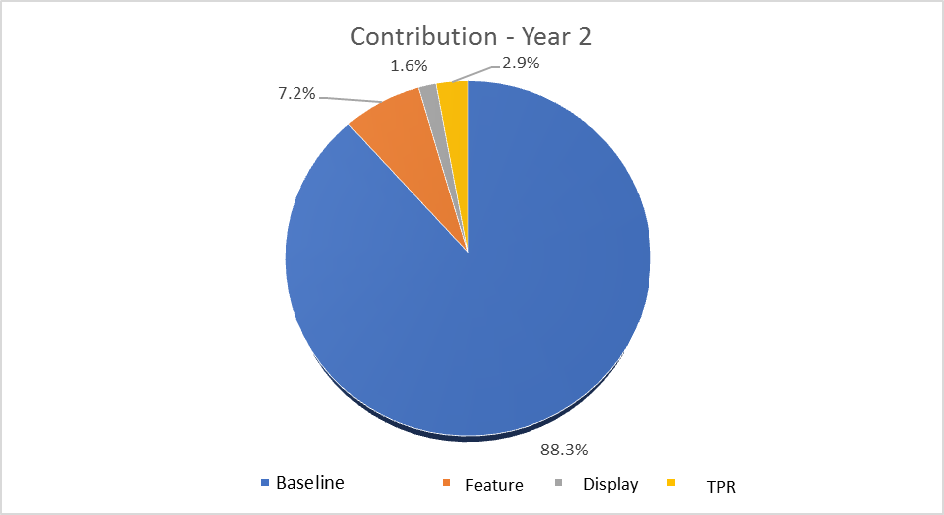
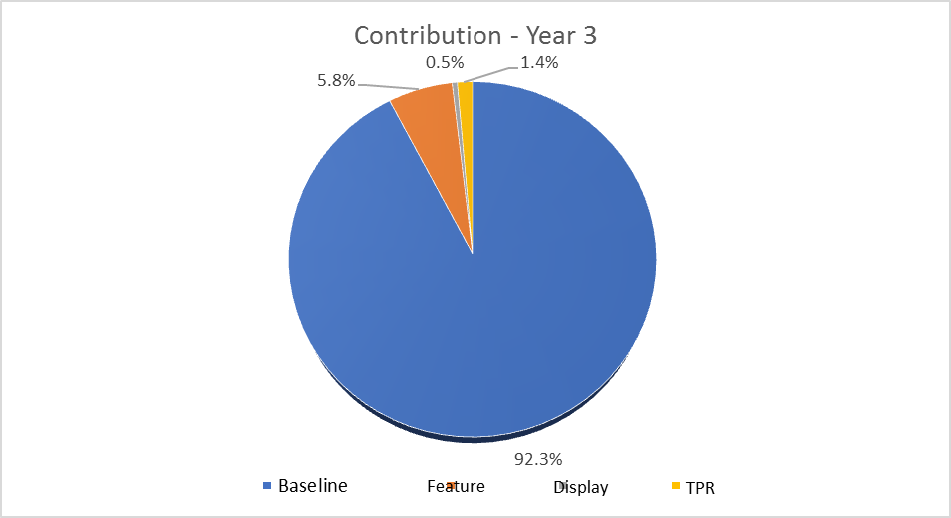
Promotion Support Change Over Two years
No of Promotions | Feature | Display | TPR
2009 | 67 | 133 | 167
2010 | 69 | 131 | 187
2011 | 71 | 106 | 148
Baseline sales in 2011 was more than 2010
Incremental Sales (promotion) in 2011 was less than 2010, maximum % reduction observed in Display category
In all 3 years, Percentage contribution of sales due to Feature was more than TPR which was more than Display

Slide 16
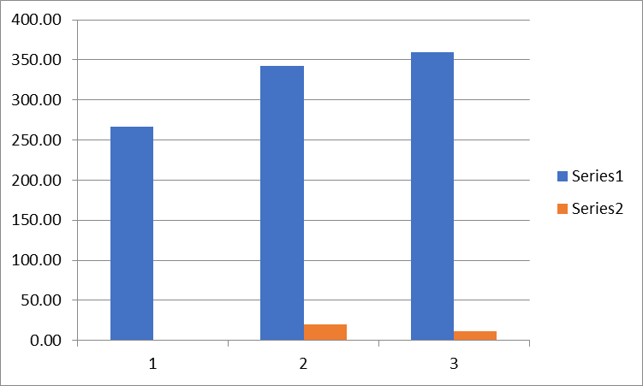
Promotion Effectiveness – Year Wise
High Segment : Bag Snacks

Slide 17
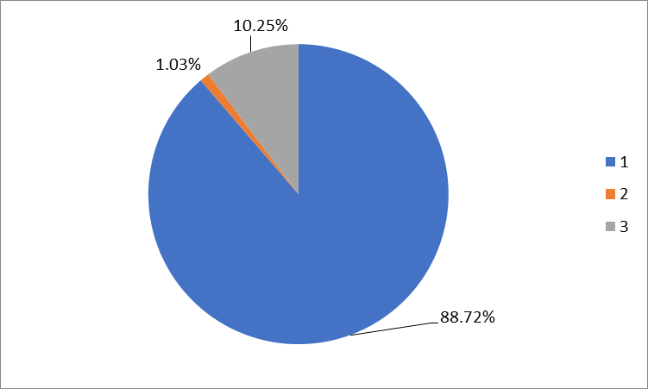
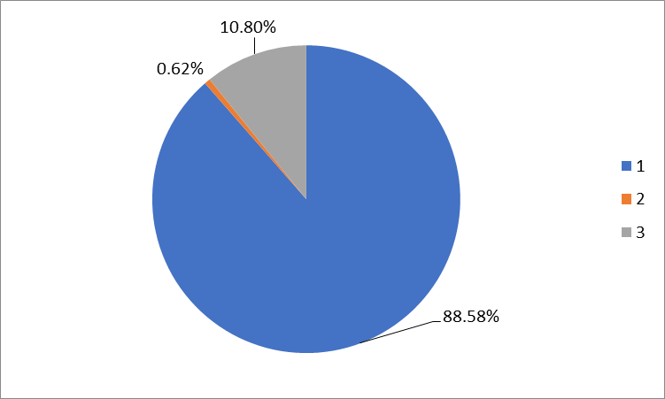
Promotion Support Change Over Two years
No of Promotions | Feature | Display
2009 | 0 | 267
2010 | 20 | 342
2011 | 12 | 360
Baseline sales and Incremental sales are comparable between 2010 and 2011
Feature promotion decreased whereas Display increased between 2010 and 2011
Display is more effective than Feature

Slide 18
Insights
Stores in the High Cluster Segment (7 Nos), all belonged to State of Ohio with MSA Code 17140
Important Feature in this segment : Total Sales, Number of Promotions, Store Area and Average Weekly Baskets.
In the High Segment Cluster, for Frozen Pizza Category, Feature was an Effective Promotion Technique
In the High Segment Cluster, for Cold Cereal Category, Feature was an Effective Promotion Technique
In the High Segment Cluster, for Bag Snacks Category, Display was an Effective Promotion Technique
In-spite of having more number of TPR promotions over three years, the effectiveness of the same on total sales is less
Stores under Medium Cluster is spread among 4 states
Of the 40 stores from the low segment, 32 stores are in TX

Slide 19
Way-Forward
Model sales at UPC level across High Segment Category
Examine the predictive power of the model
Model can be used for determining Price Elasticity
Analysis can be extended to include the Time Series Modeling for forecasting

Slide 20
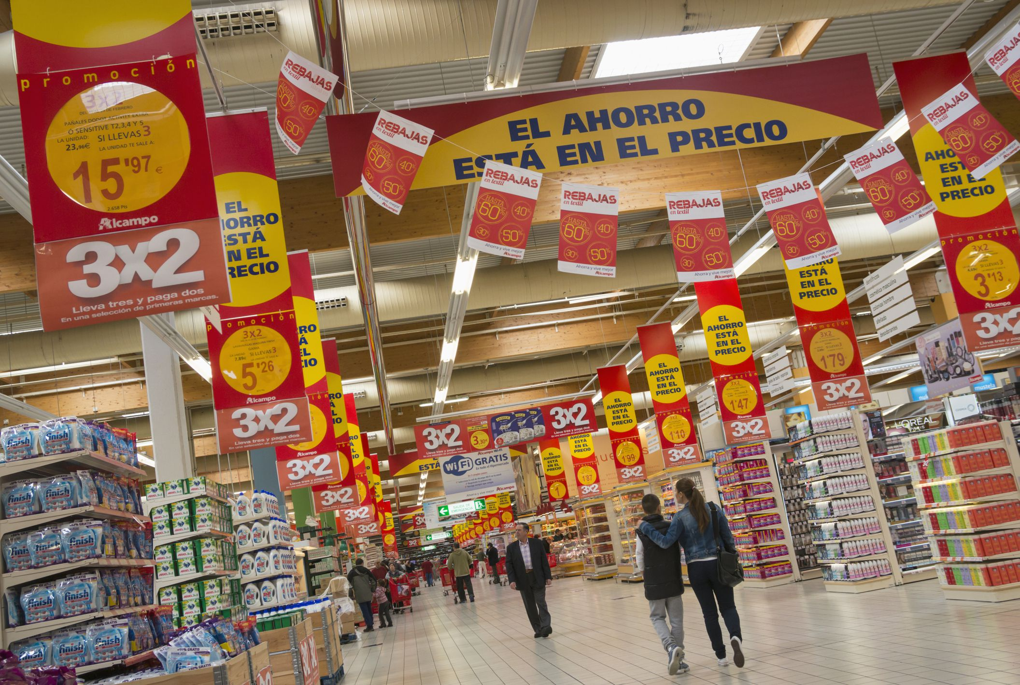
THANK YOU

